Slide 1
Software Development in the Next Decade: Beyond the Dichotomy of Open-Source and Corporate Worlds
Jinglei Ren¹ and Hezheng Yin²
Persper Foundation
¹ Microsoft Research
² UC Berkeley
(Advised by Armando Fox from UC Berkeley)

Slide 2
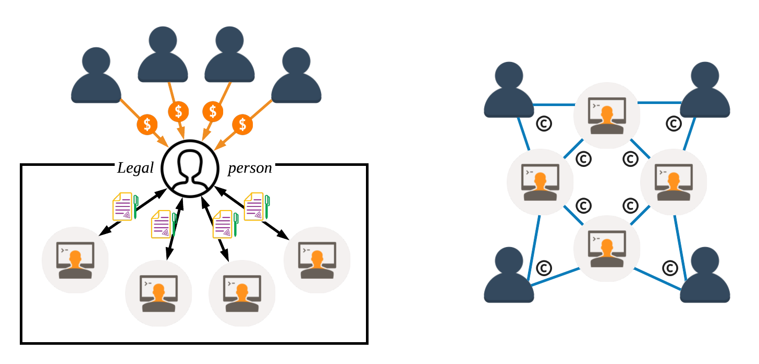
Corporate World vs. Open-Source World
Users
Developers

Slide 3
Classic Open Innovation
H. Chesbrough, Open Innovation: Renewing Growth from Industrial R&D, 10th Annual Innovation Convergence, Sept 27, 2004.
Notes:
One example: interaction with open source

Slide 4
Why the dichotomy of the two worlds?

Slide 5
Overview
Reasons leading to the two worlds
Information asymmetry
Transaction cost
Imperfect solutions
Technologies with potentials
Assessing the value of code contributions ➟ Information asymmetry
Decentralized value sharing ➟ Transaction cost
Virtual shareholding: Beyond the dichotomy
Value-shared open source
Virtual open corporation
Virtual closed corporation

Slide 6
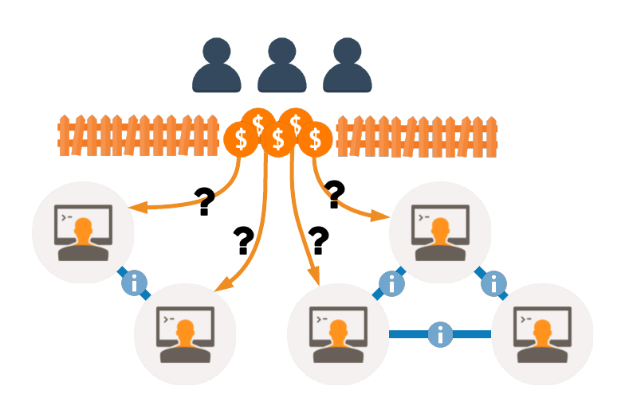
Information Asymmetry
How to allocate value?
Users don't understand developers' work.
Individual developers lack a consistent global view.
Practice in corporation: Corporate structures
Practice in open source: Relinquish the value

Slide 7
Transaction Cost
Suppose n developers and m users
# of contracts ≅ n² + nm
Dynamics of the network
Turnover of developers
Churn of users
Practice in corporation: Legal person
Practice in open source: Open source license
Licensed under Shutterstock Standard License

Slide 8
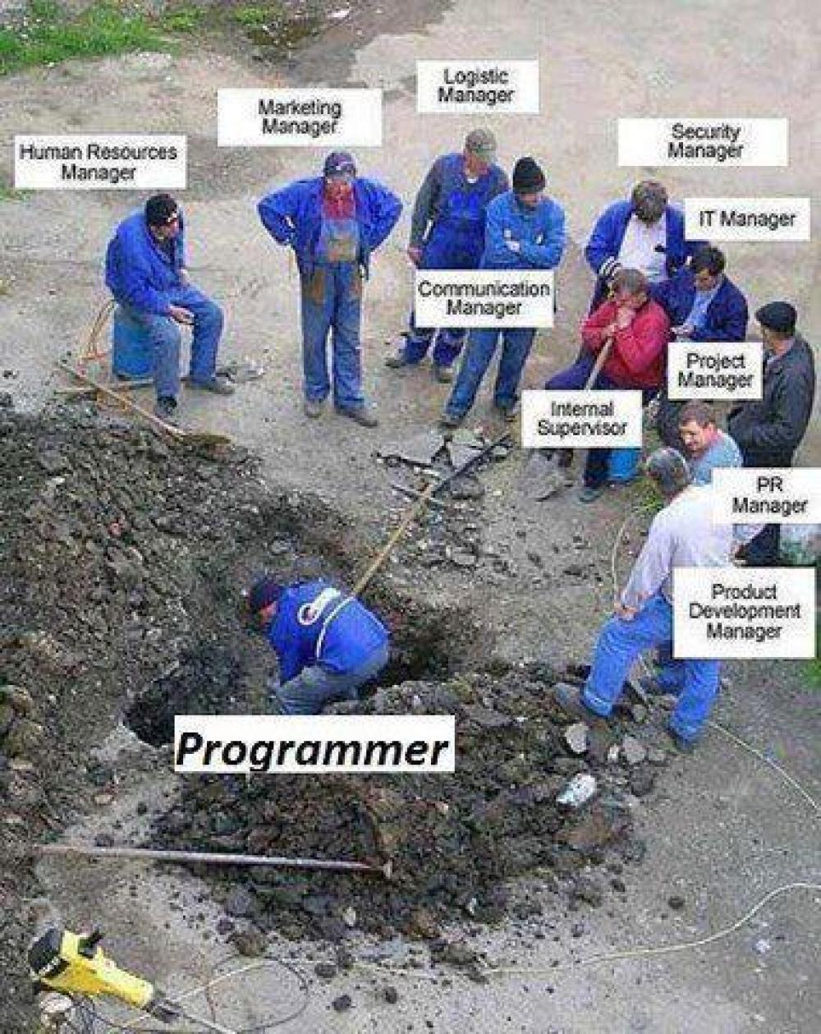
Corporate Issues
Unfair value allocation
Bias on personality and social relationships
Why employees leave: “low salary” (69.44%); “overworked” (63.12%); “lack of recognition or reward” (45.24%); “boss didn’t honor commitments” (43.49%).
Unnecessary operating overhead
Your code is not yours!

Slide 9

Open-Source Issues
Financial crisis
“The worst vulnerability found... since commercial traffic began to flow on the Internet.”
-- Joseph Steinberg, Forbes.
“Free Can Make You Bleed.”
-- John Walsh, SSH Communications Security.

Slide 10


Open-Source Issues
No general method for value allocation
“… if he took some of the money, then it seemed fair for other contributors … [to take some].”
-- Evan You, creator of vue.js.
Linus’ Law:
“given enough eyeballs, all bugs are shallow”

Slide 11
Corporation and open source are compromises.

Slide 12
Assessing the Value of Code Contributions
Various definitions of value (e.g., market price)
Development value
Development labor embodied in a code contribution
Development labor that the code contribution saves
Abstract development labor in general
Assume a hypothetical average developer
Similar to the abstract human labor in classic economics
A coherent concept for building the model
Notes:
Code

Slide 13
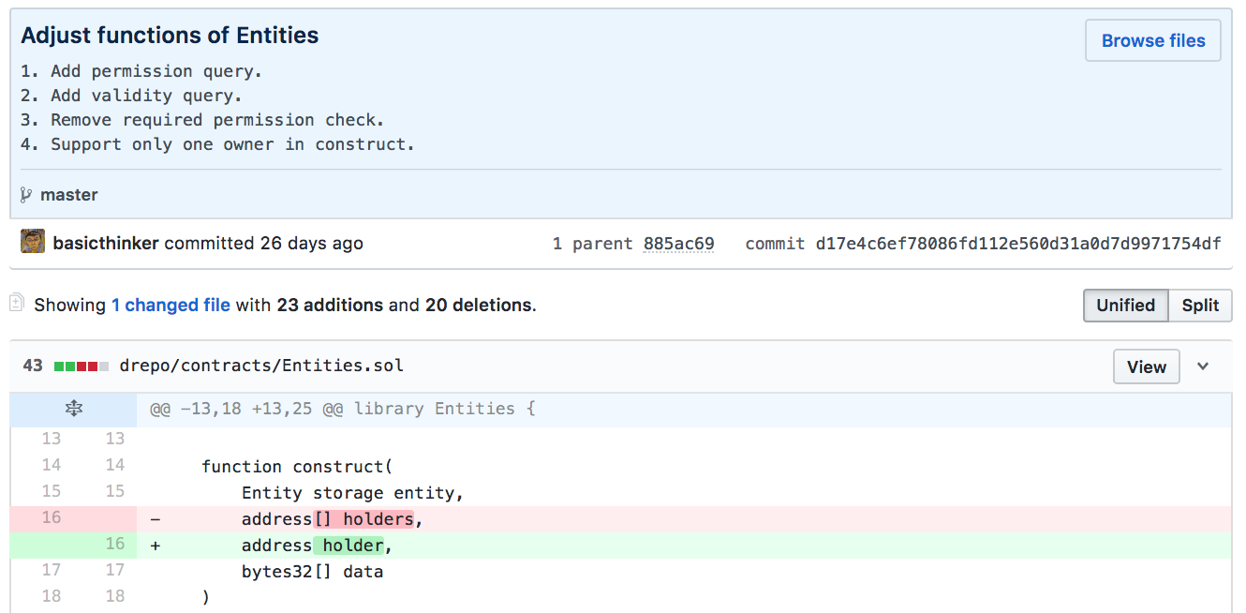
Assessing the Value of Code Contributions
Basic metric of development labor
Commits, additions, and deletions
Our metric: # of changed LOCs

Slide 14
Assessing the Value of Code Contributions
Commit-specific calibration
E.g.: a fix to a very hard-to-track bug
A few lines solve a huge issue!
Such a commit requires an large effort of an average developer
Program analysis and natural language processing/machine learning
Code structure ➟ Reuse of code
Commit messages + large developer surveys ➟ Commit-specific calibration

Slide 15
Decentralized Value Sharing
A blockchain is an immutable ledger of user-defined records
Smart contracts
E.g., “store received tokens in the current account; upon the 1st day of every month, divide the balance by total shares and transfer dividends to shareholders.”
Transparent
Unstoppable
Tamper-proof
Reduce the cost of trust-building, contracting and enforcement
Much more expressive than open source licenses

Slide 16
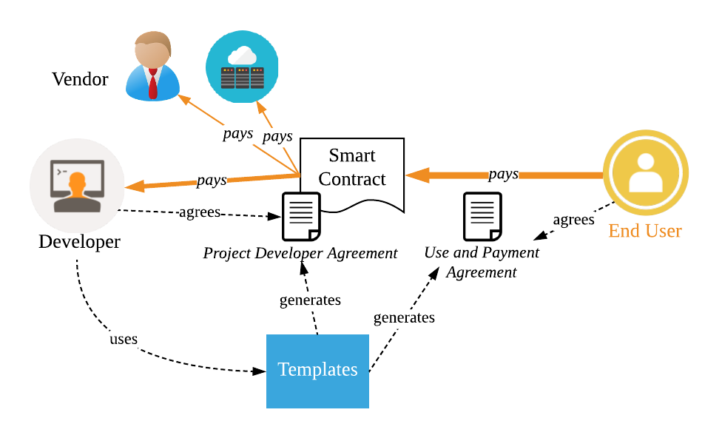
Decentralized Value Sharing
Framework/workflow
Value assessment and value sharing are integral.

Slide 17
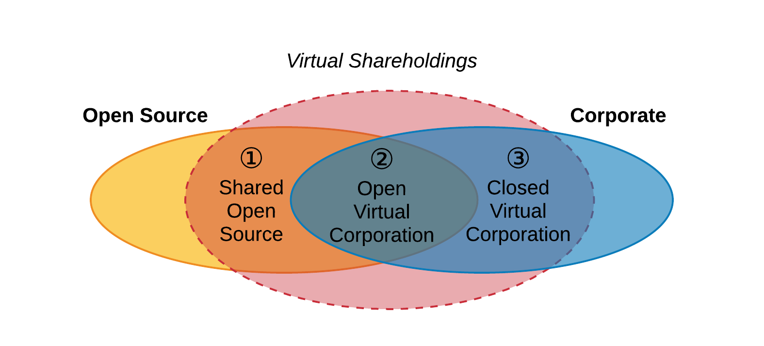
Virtual Shareholding: Beyond the Dichotomy

Slide 18


Virtual Shareholding: Beyond the Dichotomy
 | Traditional open source | Traditional corporation | Value-shared open source | Open virtual corporation | Closed virtual corporation
Financial risk
Fair allocation
Global talent
Long-term return

Slide 19
Outlook: Open Research Questions
Gaming behavior and counteraction
Influence on the project governance
Real application!
Persper Foundation
Sponsor selected open source projects with $10,000 per month for 6 months.
How would developers react?

Slide 20
Assessing the Value of Code Contributions

Slide 21
Goal
“ … and it becomes a problem how to properly quantify and measure the work that each contributor does.”
-- Evan You, creator of Vue.js
Goal: Assess the value of code contributions in a way that’s
Consistent (produce same results for same codebase each time)
Efficient (automatable so minimal human effort required)
Accurate
(true value -> expert developer’s assessment)

Slide 22
Development Value (Dev Value)
Observation: Two types of code tend to have high value
Addresses a time-consuming dev task
Saves a huge amount of development effort for other developers
Definition: Dev value of a code contribution is the sum of
Development labor embodied in itself
Development labor that it saves other developers

Slide 23

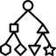

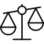

Dev Value = Structural + Non-structural Value
Structural value: role of code in codebase structure
Non-structural value: other impact of code on the team
Learning To Rank (L2R): combining structural and non-structural value
A Code Contribution
Structural
(DevRank)
Non-structural
(Impact Coding)
Learning To Rank
Dev Value

Slide 24
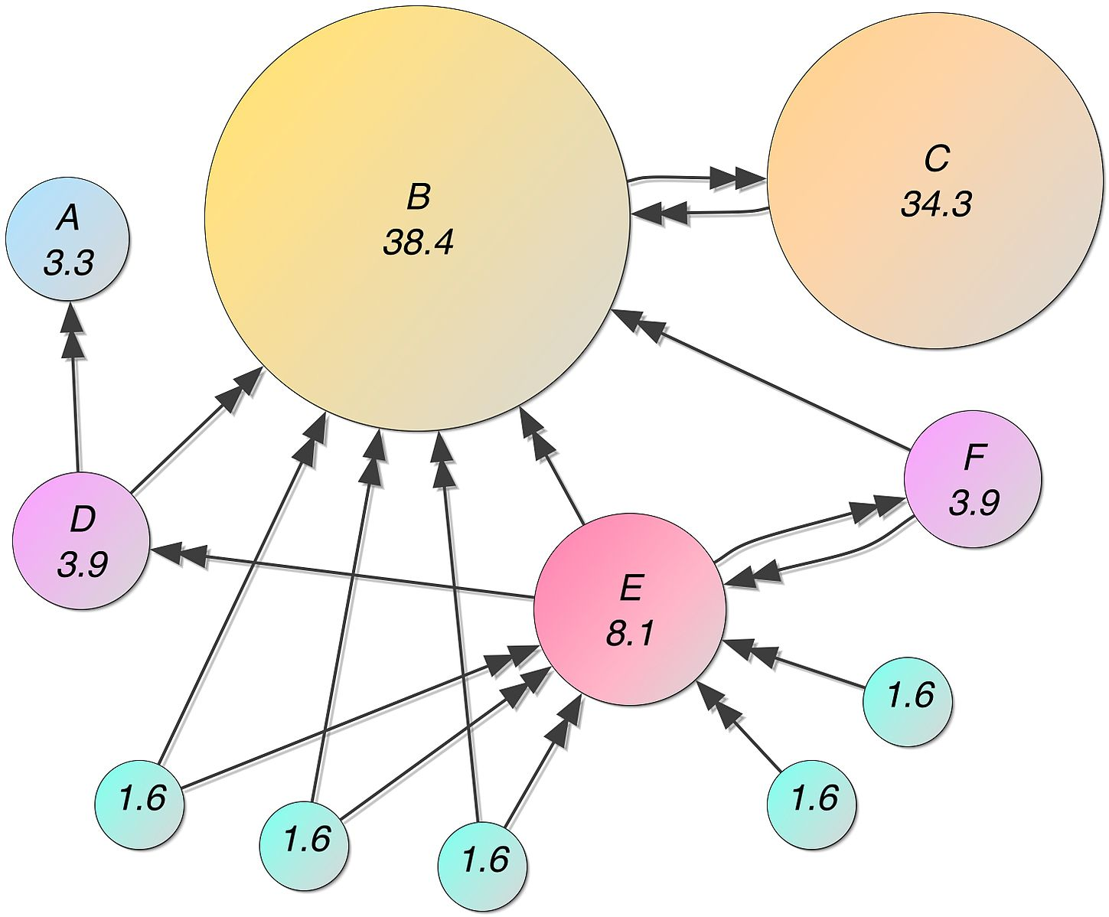
Measure Structural Value: PageRank
What is PageRank?
Used by Google to rank websites
Assigns a numerical score to any given webpage
Higher score -> more important
How it works?
Runs on a directed graph representing the web structure
All nodes start with equal score
In each iteration…
Repeat until reaches a fixed point
Figure: PageRank for a simple web graph (in %)

Slide 25
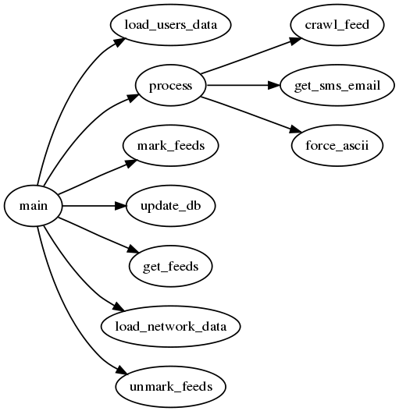
Measure Structural Value: Call Graph
Figure: A simple Python Call Graph
http://blog.prashanthellina.com/generating-call-graphs-for-understanding-and-refactoring-python-code.html
Figure: PageRank for a simple web graph (in %)

Slide 26
Measure Structural Value: DevRank
As a result, two qualities would contribute to high DevRank value
High in-degree
High dev labor
Align well with our definition of development value
 | PageRank | DevRank
Node | Website | Function
Edge | Hyperlink | Function call
Weight on edge | Equal weight | Proportional to dev labor

Slide 27
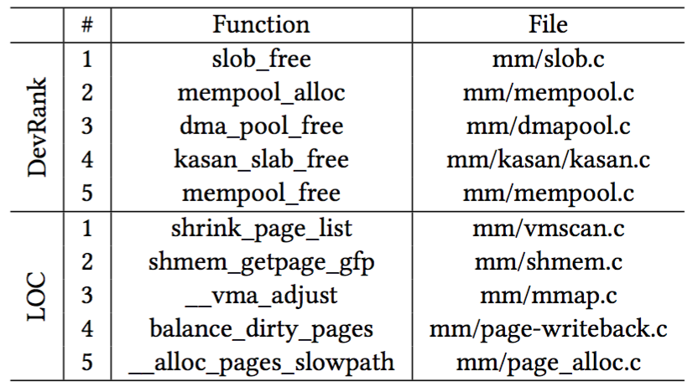
DevRank Results on Linux Kernel Project
 | slob_free (DevRank) | shrink_page_list (LOC counting)
# lines | 81 | 412
# times called | ≈ 7,000 | 2
Note: Calls to slob_free are mostly through kfree.
Table: Most valuable functions under mm directory

Slide 28
Measure Non-structural Value: Impact Coding
Not all dev value is captured by the code structure
Interviewed 3 veteran open source developers
Author of a popular Twitter client
Two FreeBSD developers
Q: “How would you compare the value of two commits?”
A: ”…classify commits by its impact...”
Ranking | Commit Type
1 | Fix for build errors
2 | Fix for severe non-build errors
3 | Important new features
4 | Fix for severe speculative errors
5 | Fix for minor errors
6 | Regular new features
7 | Cosmetic errors
8 | Source code hygiene
Table: Hierarchy of commit value, by a FreeBSD developer

Slide 29
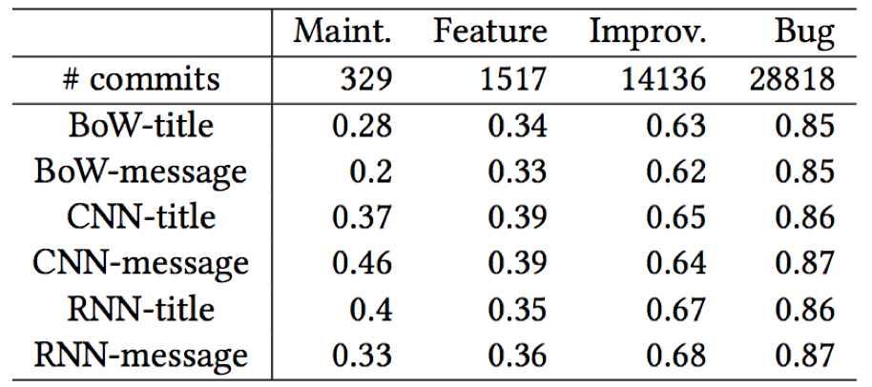
Can We Automate Commit Classification?
Solution: text classification on commit messages
Classify N = 267,446 JIRA issues into one of four categories
Maintenance
Feature
Improvement
Bug
Trained 3 classifiers on 2 types of inputs (msg title/entire msg)
Table: Performance (F1 score) of three NLP + ML models for JIRA experiment

Slide 30
Combine Structural and Non-structural Value
Notations
d: devrank value
t: impact type of a commit
v: overall development value
Our approach: Learn weight vector w from data provided by expert developers
Ask many developers to compare random pairs of commits, identifying which in each pair is more valuable
Use Learning to Rank to learn from this “pairwise ground truth”

Slide 31
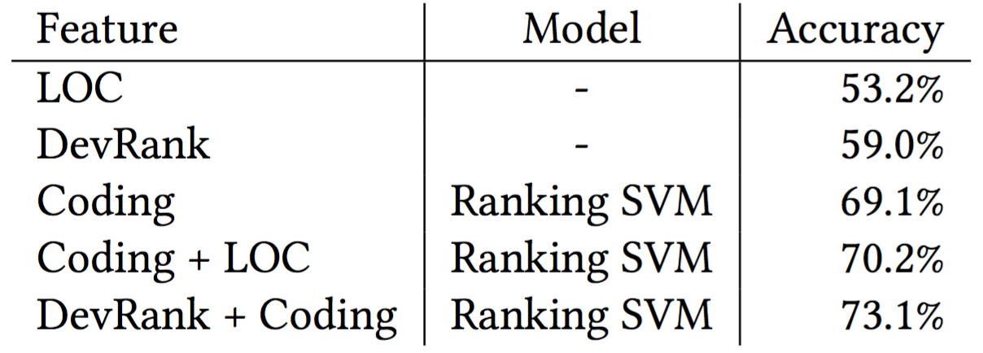
Results: Commit Value Comparison Task
Our dataset
772 commit pair comparisons
Contributed by 35 developers from FreeBSD & Linux Kernel

Slide 32
Conclusion
Assessing the value of code contributions is difficult for developers
Inherent subjectivity
Few developers have a wide enough view of the entire project
We postulated that a given code contribution has both
Structural value
Non-structural value
We proposed a combination of
A PageRank-inspired algorithm
An impact coding scheme

Slide 33

Thank You!
https://twitter.com/dPersper
https://medium.com/persper
https://fb.com/persper.foundation
Recent articles
What We Talk about When We Talk about a Decentralized GitHub
Light on the Dark Side of Network Effects

Slide 34
Backup
Non-code contributions
“The most important feature of Linux, however, was not technical but sociological.”
—Eric S. Raymond, The Cathedral & the Bazaar, 2001.

Slide 35
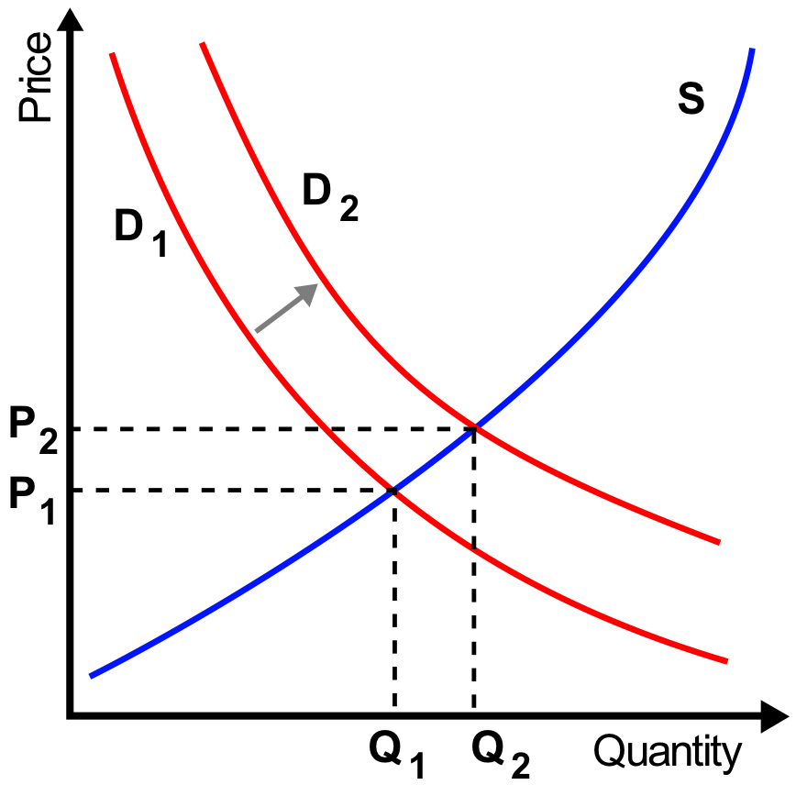
Backup
Other incentives than money

